Slide 2
Polyunsaturated Fatty Acid Intake and Its Correlation with Positive and Negative Syndrome Scale (PANSS) in Schizophrenia Patient
Mertien Sapang; Miftahull Hassana;
Nadiyah
Universitas Esa Unggul
mertien.sapang@esaunggul.ac.id

Slide 3
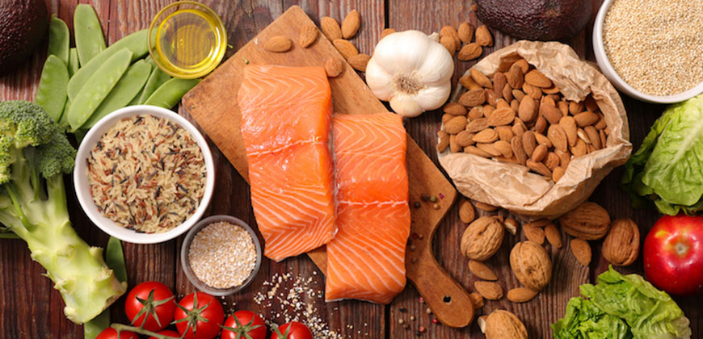
Introduction
Schizophrenia
PUFAs
Neurodevelopmental
The treatment of schizophrenia is commonly viewed from a pharmacological and social perspective, but issues of nutrient intake are seldom examined. However, the various study reported that PUFAs play important roles in the development and maintenance of normal central nervous system (CNS) structure and function. Therefore PUFAs intake may have a correlation with psychiatric symptoms in schizophrenia patients.

Slide 4
MATERIALS AND METHODS
Study Design and participants
This cross-sectional study was conducted on 63 schizophrenia hospitalized patients in Ernaldi Bahar Hospital, South Sumatra, Indonesia
PUFAs Intake
Collected using a combination of a 3-day weighed food records and weighing-back methods
Dietary data were converted into PUFAs intake using the Indonesia fatty acid composition table, list of Indonesian food fatty acid content, Singapore Food Nutrition Composition and Nutrisurvey software
Correlation between PUFAs intake (Omega-3; Omega-6; Ratio of Omega-6/Omega-3) and Psychiatric symptoms (Positive scale; Negative Scale; General psychopathology; Risk of aggression) were tested using the Spearman Correlation Coefficient.
Statistic analysis

Slide 5
Positive and Negative Syndrome Scale
Psychiatric symptoms were assessed using Indonesian version of PANS.
PANS consists of 33 items including 7 positive scale items, 7 negative scale items, 16 general psychopathology items, and contains 3 additional points to meet the risk of aggression.
The assesment was conducted by certified nurse.

Slide 6
Correlation between PUFAs intake with PANSS score
PUFA | Positive scale (r) | Negative Scale (r) | General psychopathology (r) | Risk of aggresion (r)
Omega-3 (g/day) | -0.345* | -0.408* | -0.483* | -0.406*
Omega-6 (g/day) | -0.390* | -0.496* | -0.525* | -0.389*
Ratio of Omega-6/Omega-3 | 0.249* | 0.256* | 0.356* | 0.343*
r=correlation coefficient
*Significant with p value <0 .01

Slide 7
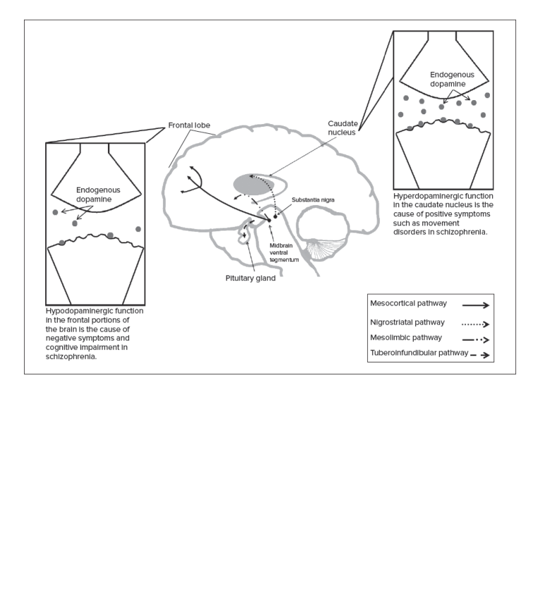
Correlation between Omega-3 intake with PANSS score
Decrease dietary omega-3 fatty acids
Source: Modified from Patel KR, Cherian J, Gohil K, Atkinson D. Schizophrenia: Overview and Treatment Options and Ohara K. The n-3 polyunsaturated fatty acid/dopamine hypothesis of schizophrenia. Progress in Neuro-Psychopharmacology and Biological Psychiatry. 2007 Mar;31(2):469–74

Slide 8
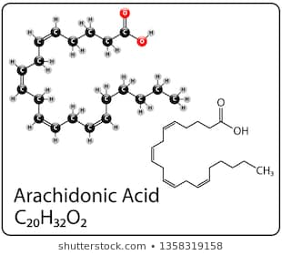
Correlation between Omega-6 intake with PANSS score
The beneficial effects of omega-3 fatty acids in psychiatric disorders are well publicized, but the omega-6 fatty acids role are seldom discussed. Previous studies showed that sufficient levels of omega-6 (especially AA) are required to improve neurological health. Meanwhile, AA concentration is found reduced in peripheral blood measures of schizophrenia patient. This condition suggests that increase AA intake may have a positive impact on psychiatric symptoms in schizophrenia patient.

Slide 9
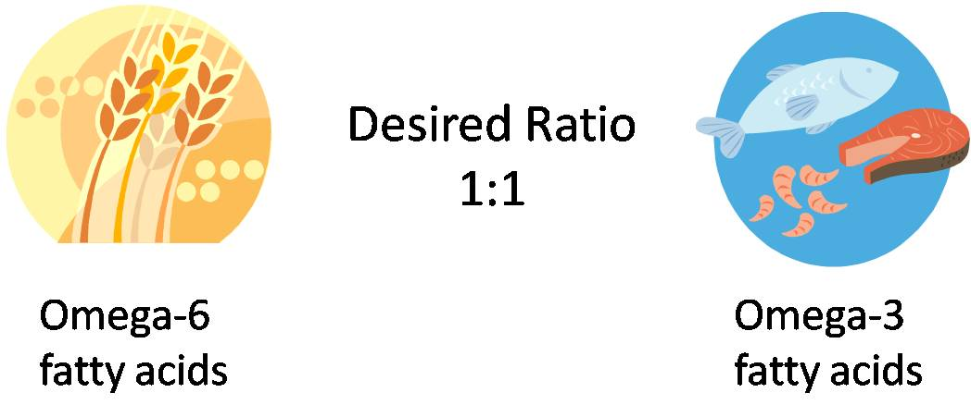
Correlation between Omega-6 intake with PANSS score
Previous study showed that increase omega-6 to omega-3 ratio may be induce of a pro-inflammatory response. Therefore a stronger inflammatory response may increase the production of free radicals and reduce PUFA levels. Reduced anti-inflammatory activity may be involved in negative symptoms and cognitive impairment observed during the acute stages of schizophrenia episodes

Slide 10
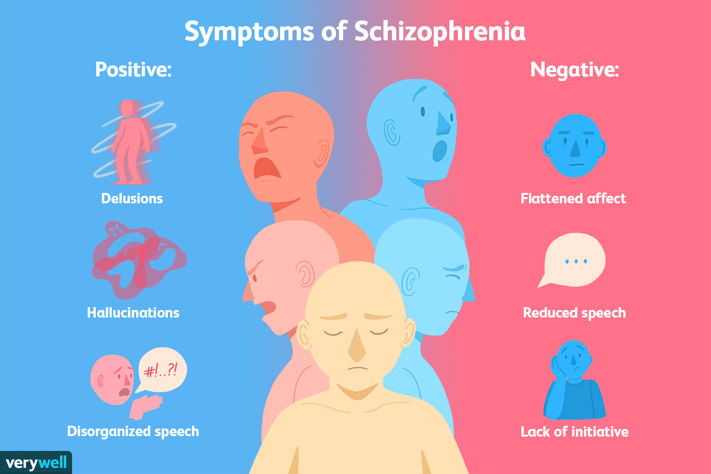
THANK YOU

